Slide 1
Flight Difficulty Score: Systematic Assessment of Operational Complexity at Chicago O'Hare
Lovish Rawat and Chirag Rawat

Slide 2
Table Of Contents
Delay Data……………………………………………………………………………………….3
Ground-time Buffer………………………………………………………………………….5
Bag Ratio………………………………………………………………………………………….6
Passenger Load Data………………………………………………………………………..7
SSR Data………………………………………………………………………………………..…8
Difficulty Rank…………………………………………………………………………..……10

Slide 3
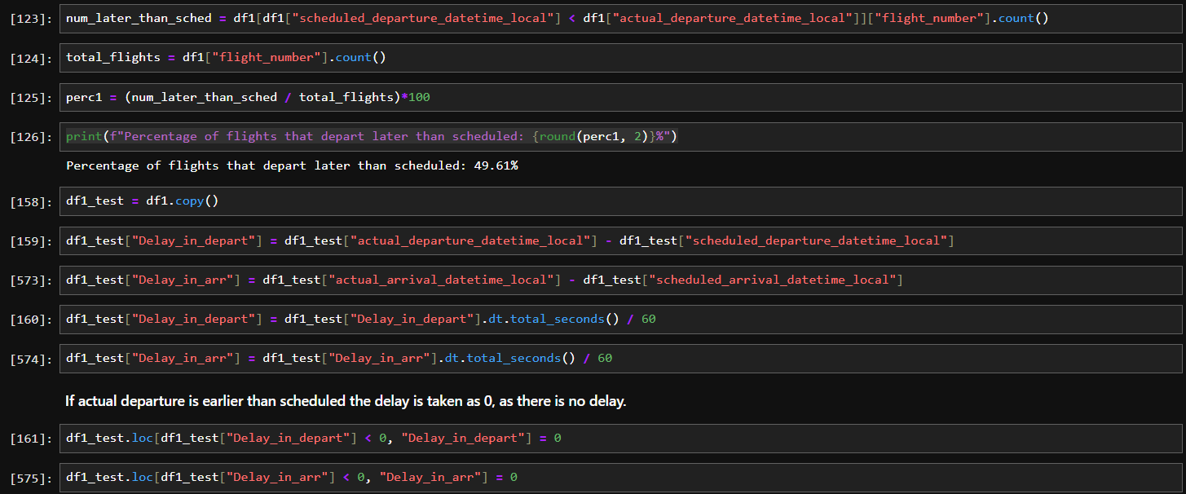
Average Delay
Percentage of flights departing later than scheduled came out to be 49.61%.
If the flights are earlier than scheduled, the delay is taken 0, instead of negative values.

Slide 4
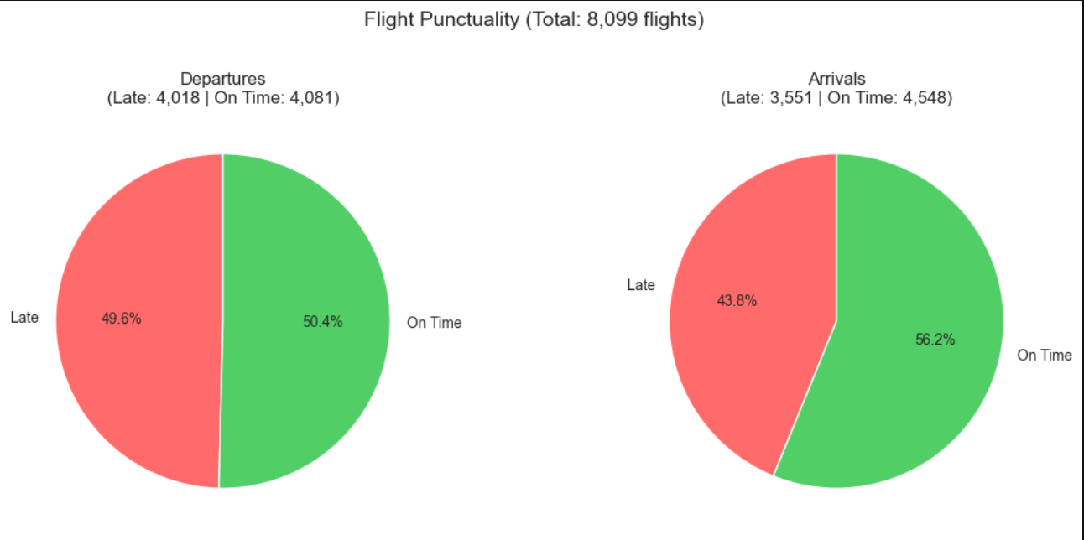
Departure and Arrival Charts
The charts display the proportion of late versus on-time departures and arrivals.
A small gap exists between Chicago late departures and late destination arrivals, suggesting operational disruptions in departures.

Slide 5
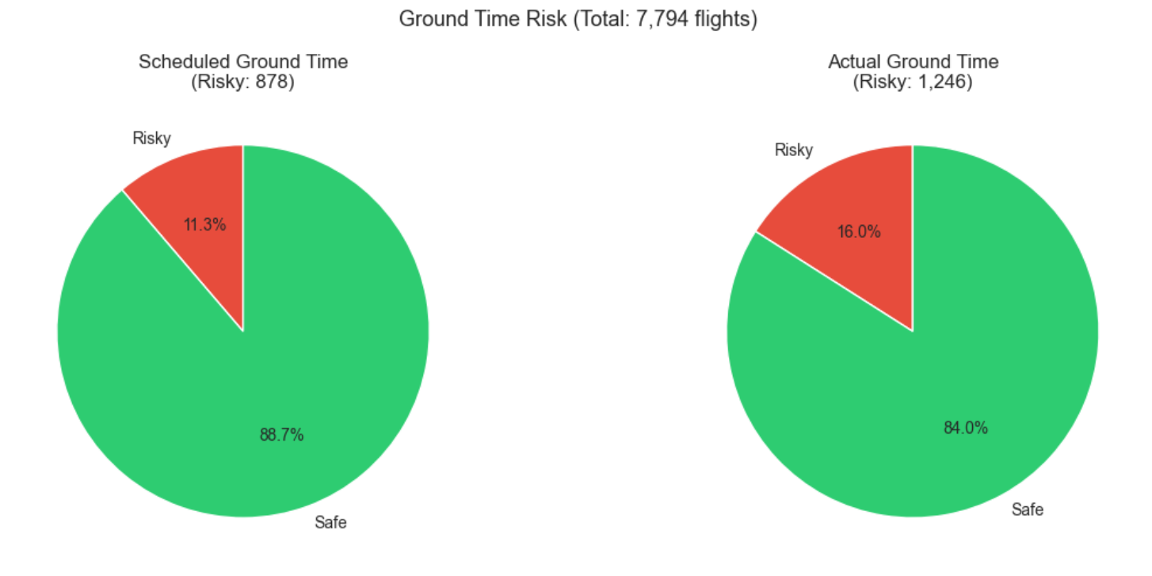
Ground-time Overrun
The charts display the proportion of risky versus safe flights(based on their ground-time).
Actual ground time falls shorter of the minimum threshold compared to scheduled ground time, suggesting flights are operating with tighter turnarounds than planned.
The chart takes the margin of 10 minute to consider its closeness with the minimum ground time.

Slide 6
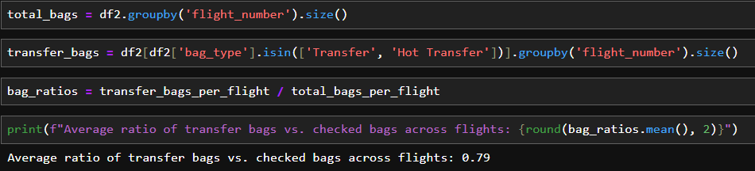
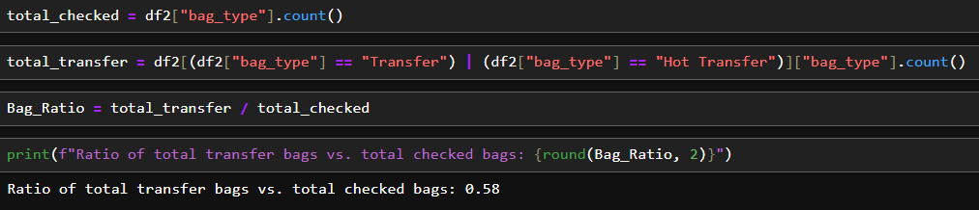
Bag-Ratio
Bag-Ratio is calculated according to their flight numbers and then we just took its mean.
We also calculated the ratio for total number of bags.

Slide 7
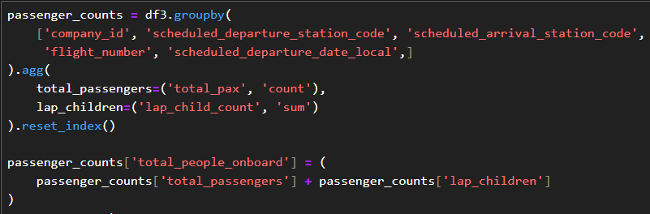
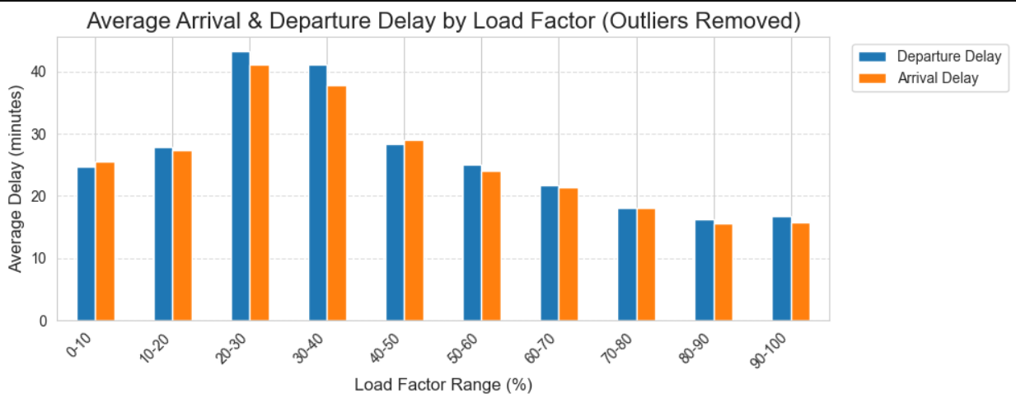
Passenger Load Data
Passenger count is taken by adding the number of pax and lap child count. Load factor is then calculated by diving the total people onboard with total seats.
The chart shows delays based on the load factor range. It is visible that delays are less when the plane is either completely full or has very less passenger load.
Load factor range of 20-40% suffers from the most delays.

Slide 8
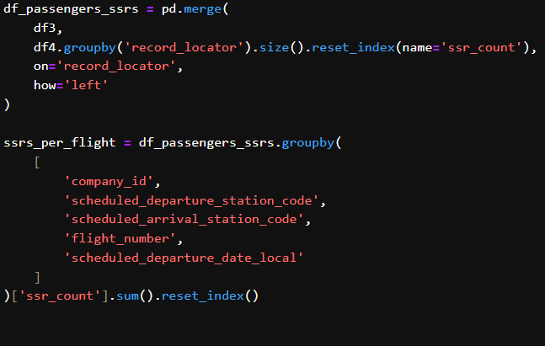
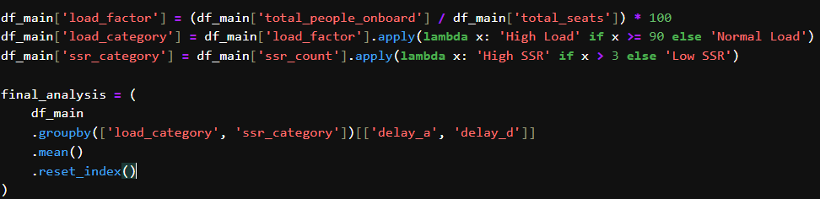
SSR Data Classification
SSRs are counted grouping by 5 merge keys for specifying flight.
For SSR, if the count is greater than 3, it is considered ‘High’. Similarly, for a load factor greater than 90, it is considered ‘High’.
It is then displayed with both arrival delay and departure delay.

Slide 9
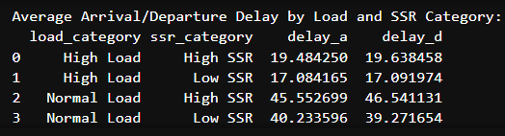
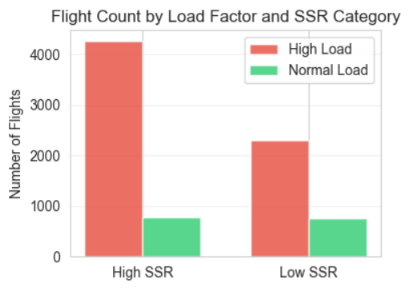
SSR Data Display
It is visible that on average delays are greater for High SSR, than Low SSR.
Also for high load delays are less, as seen in previous slides
The majority of flights have high SSR counts, creating a sample size imbalance. Therefore, the higher average delays observed in high-SSR flights may be influenced by this distribution rather than causation.

Slide 10
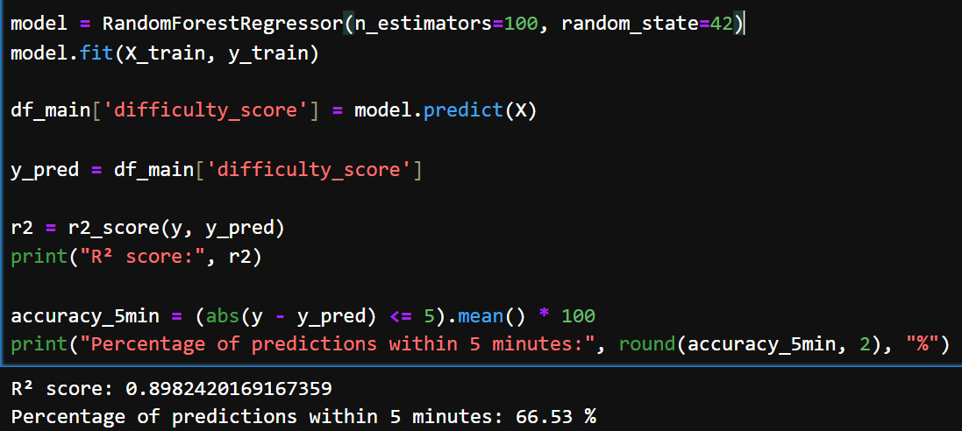
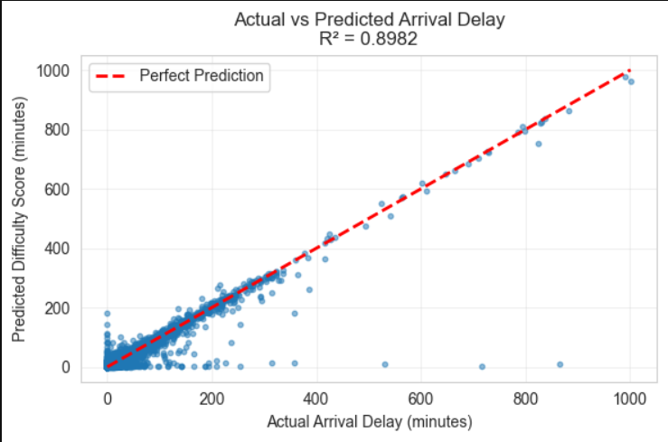
Difficulty Score
Difficulty scores are generated using a Random Forest model that predicts arrival delay based on departure delay and ground time overrun.
Model showed good variance score and about 2/3rd of the data was predicted within 5 minutes of the actual value.
Actual vs Predicted value of arrival delay.
Hyperparameter tuning could be used to enhance model performance and accuracy.

Slide 11
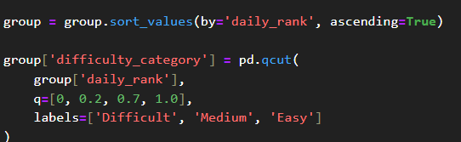
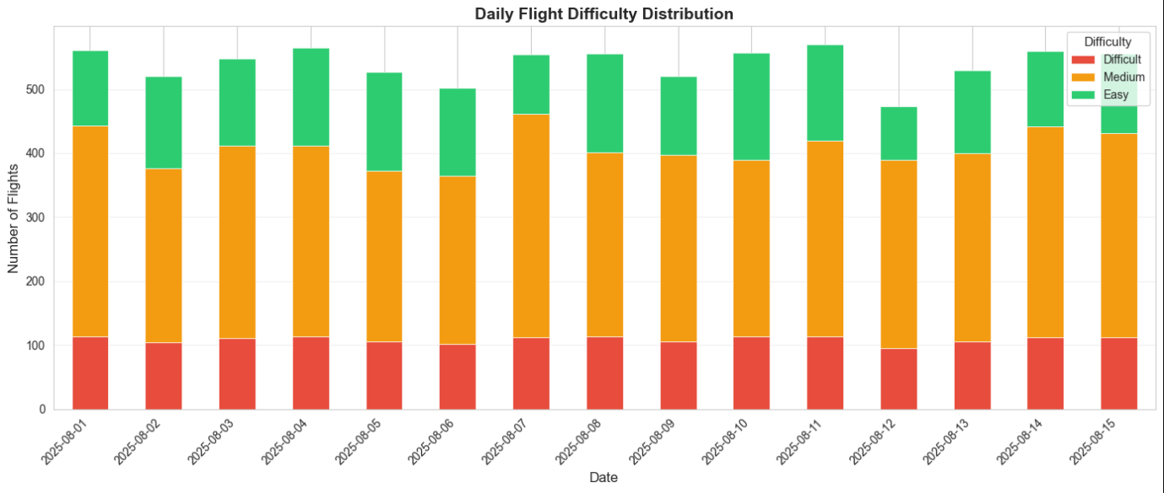
Rank and Classification
Labels are given using quantile cut on daily rank which was given using difficulty scores.
The chart shows number of flights with their difficulty for all the dates.

Slide 12
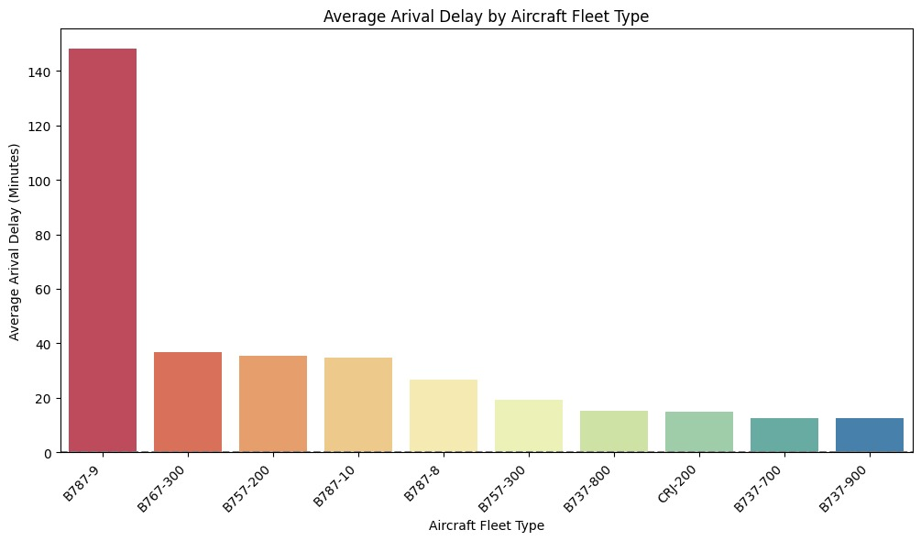
Arrival Delay vs Fleet Type

Slide 13
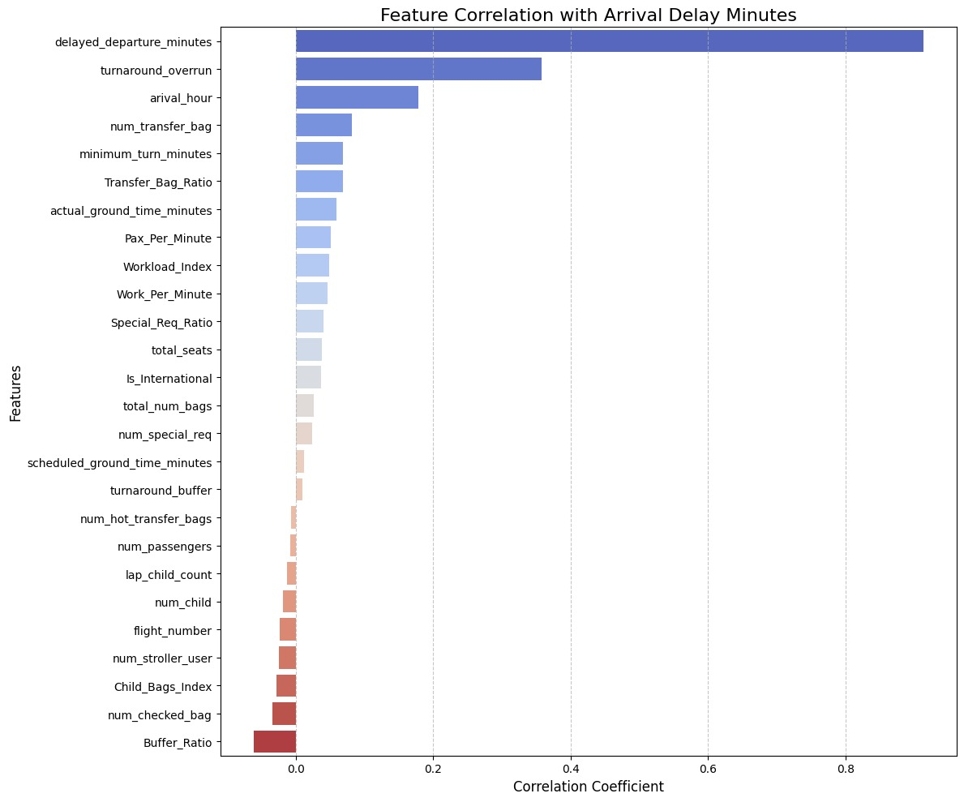
Arrival Delay Correlations with all the features

